Slide 1

THE BENEFITS OF PHYSICAL ACTIVITIES
IN PATIENTS WITH DUAL DIAGNOSIS
Centro de Estudos

Slide 2
Statement of Potential Conflicts of Interest
THE BENEFITS OF PHYSICAL ACTIVITIES
IN PATIENTS WITH DUAL DIAGNOSIS
Relative to this presentation there are no relationships that could be perceived as potential conflicts of interest

Slide 3
INTRODUCTION
This work describes the benefits of physical activities in patients with dual diagnosis in a psychiatric clinic in the city of Rio de Janeiro, Brazil.
The objective of the present study was to analyze the importance of physical activity in 45 patients with Dual Diagnosis, according to the classification of mental disorders ICD-10, hospitalized in a psychiatric hospital.
During the treatment, psychotropic drugs were used according to the diagnosis, signs and symptoms presented. The sample consisted of 45 patients with mean age of 35 years.
Regarding the gender, 84% of the male gender while 16% female. Of these, 84% have completed elementary education, 12% completed highschool, and 4% completed an graduation.

Slide 4
METHODS
The study lasted for one (01) year from January 2016 to February 2017. Before starting the practices proposed for the present study, the weight, height and calculation of the Body Mass Index (BMI) of the subjects submitted to the study. All patients were evaluated by a general practitioner, a psychiatrist, and a physiotherapist.

Slide 5
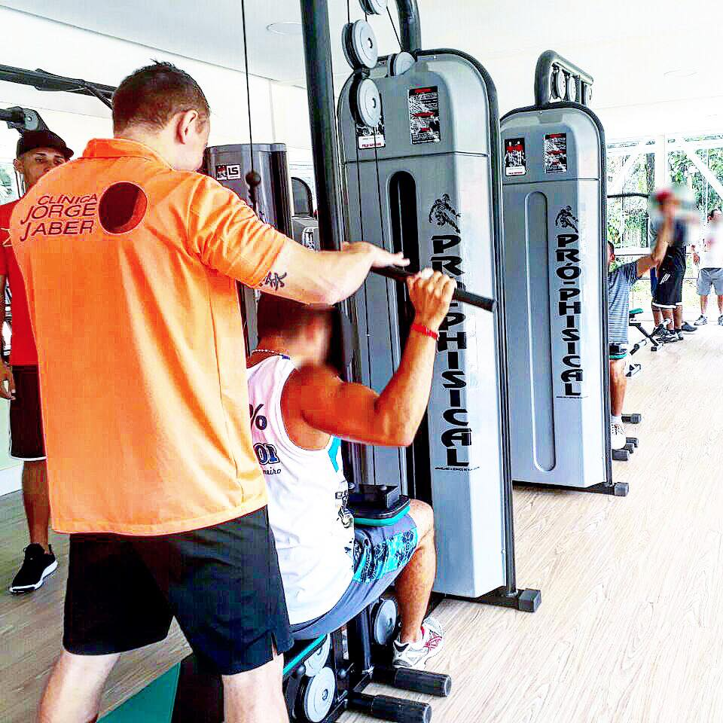
Oriented physical activity

Slide 6
METHODS
The therapeutic project offered physical and psychological treatment, increasing the possibility of recovery through aerobic and anaerobic physical activities such as functional training, water aerobics, bodybuilding, volleyball and soccer, within the therapeutic environment. Application of the health, well-being and self-determination questionnaire, completed by the participants, which provided a clear picture of how the individual with a dual diagnosis in a psychiatric clinic benefits from physical activities.

Slide 7

Water gymnastics class at Jorge Jaber Clinic.

Slide 8
RESULTS
The organization chart of physical activities in the therapeutic environment: Aerobic and anaerobic play activities such as functional training, water aerobics, bodybuilding, volleyball, soccer and walking demonstrate the multi-sport practice.

Slide 9
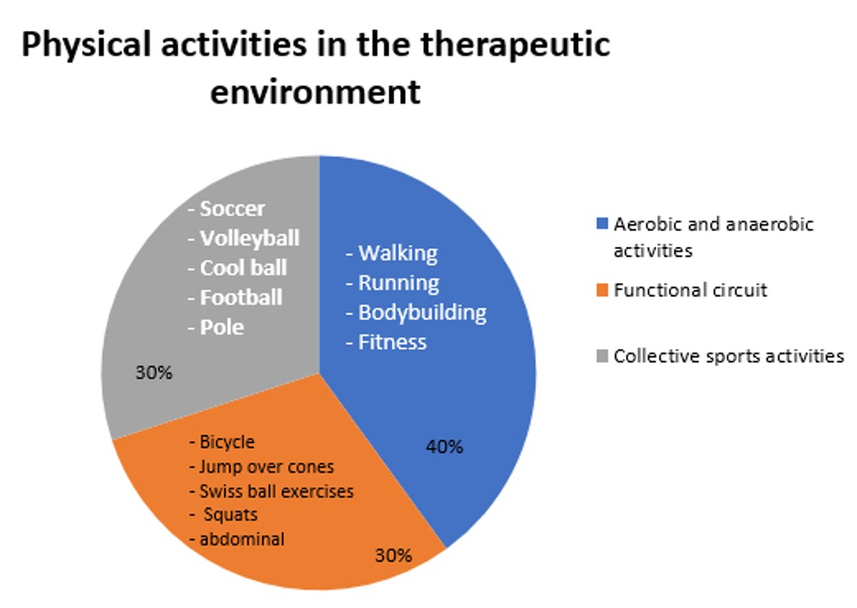
Results

Slide 10
RESULTS
Concerning the contribution to health, the participants considered the practice of physical exercises to be fundamental (62%), others considered that it contributes a lot, but it is not fundamental totaling 20.8%, while those who considered it indifferent or do not contribute at all. 11.4% and those who say, they contribute very little (1.9%)

Slide 11
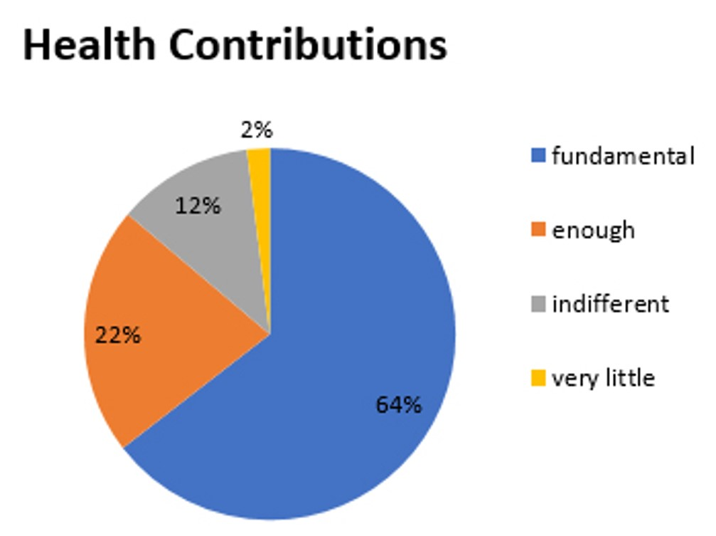
Results

Slide 12
RESULTS
Concerning well-being and self-determination, they considered that physical activity during hospitalization was essential for treatment (58.5%), others believes that it contributes a lot (20%), the contribution is low (9.4%), for some contribute nothing (7.5%) and for some, well-being and self-determination are considered as indifferent (3.8%).

Slide 13
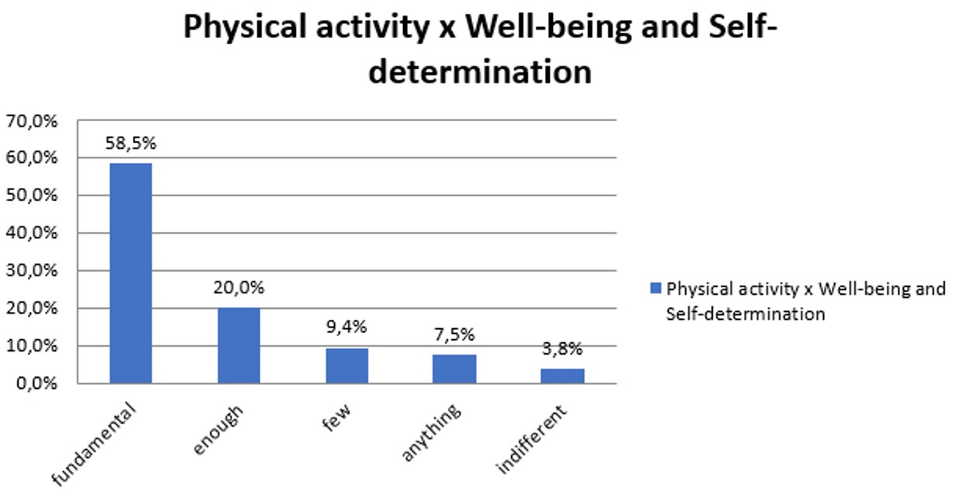

Slide 14
RESULTS
Regarding the values attributed to physical activity as a relevant and important factor in the greater adherence to the treatment of chemical dependency in patients with dual diagnosis, in a scale where five corresponds to the highest value and one to the smallest, the majority of participants considered that physical activity received a maximum value of 71.7%, 11.4% of the value four, only 1.9% attributed the value three, followed by two that covered 5.7%, while the minimum value was attributed by 9.4% of the participants.

Slide 15
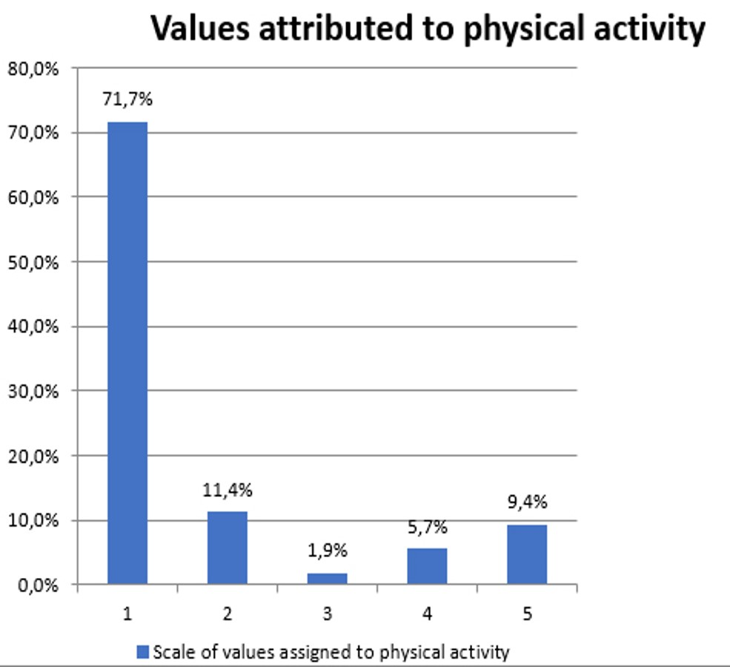
Results

Slide 16
CONCLUSIONS
Through the result we can observe the importance of physical activity in the treatment of patients with dual diagnosis, especially in the overall improvement of health, increase of well-being and self-determination, being a relevant factor in the greater adherence to hospital treatment.

Slide 17
REFERENCES
1) HELLERSTEIN, D.J.: The Urgent Challenge of Health and Nutrition Issues in Psychiatric Patients: Strategies for Assessements and Collaboration: An Expert Interview with David J. Hellerstein , MD. Art Medscape Psychiatry, 2006;
2) HERT et al: Prevalence and Severity of Antipsychotic Related Constipations in Patients with Schizophrenia. BMC Gastroenterol. 2011.;
3) MAAYAN et all; Management of Antipsychotic – Related Weight Gain. Expert Rev Neurother. 2010 Jul; 10(7)1175-1200.(1);
4) RETTENBACHER,M.A.: Disturbances of Glucose and Lipidic Metabolism During Treatment with New Generation Antipsychotics. Art CurrOpin Psychiatry.2005 Mar; 18(2). 175-9;
5) Sociedade Brasileira de Endocrinologia e Metabologia;

Slide 18
REFERENCES
6) RUMMEL-KLUGE et al; Metabolic Side Effects of Second-generation Antipsychtics. ArtEvid Based Ment Health; 2011;
7) FAUCI, A. et al. Manual de Medicina de Harrison. Porto Alegre: AMG, 2011;
8) Costa RF, Böhme MTS. Avaliação morfológica no esporte. In: Biezek S, Alves LA, Guerra I. Estratégias de nutrição e suplementação no esporte. Barueri: Manole, 2005;
9) Costa RF. Composição corporal: avaliação prárica. In: Hirschbruch MD, Carvalho JR. Nutrição esportiva: uma visão prárica. 2ª ed. Barueri: Manole, 2008;
10) Jackson AS, Pollock ML, Ward A. Generalized equations for predicting body density of women. Med Sci Sports Exerc1980;12:175-82.;
11) Durnin JV, Womersley J. Body fat assessed from body density and its estimation from skinfold thickness: measurements on 481 men and women aged from 16 to 72 years. Br J Nutrição1974;32:77-97.

