Slide 1

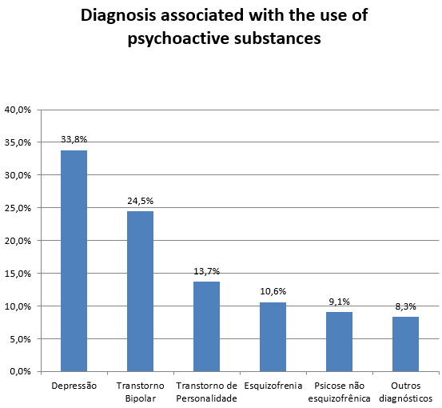
DUAL DIAGNOSIS AND TREATMENT: THE EXPERIENCE OF A MULTIPROFESSIONAL TEAM IN MENTAL HEALTH
CENTRO DE ESTUDOS
Jaber Filho, JA: Veríssimo Jr, J; ,Hollanda, A; Trapaga, R.
INTRODUCTION: The work was developed with the transversal descriptive analysis of the data obtained with a population hospitalized in a psychiatric clinic in the city of Rio de Janeiro, Brazil, in the period of five years.1.832 patients were assessed, while 494 presented dual diagnosis, that is, a association between a psychoactive substance use disorder and another concomitant psychiatric diagnosis.
OBJECTIVES: The main objective of the research is to know, in the population of hospitalized patients, the distribution of the most prevalent psychiatric diagnosis associated with the psychoactive substance use disorders.
METHODS: The work consisted of the evaluation of all the patients who were admitted to the clinic in the period of five years, from 2012 to 2016, using the ICD 10 for the diagnosis of the dual pathologies.
All the patients were evaluated by anamneses done by the professional team, composed by general practioner, psychiatrist, psychologist, therapist in chemical dependency, family therapist and physical therapist. Biochemical examinations were done and, when necessary, neuroimaging and neuropsychological examinations were requested. The patients were treated with the use of psychoactive drugs, cognitive behavioral psychotherapy, a 12-step program, art therapy and moderate physical activity. Relatives of all the patients were also interviewed.
RESULTS: In the evaluation carried out, it was found the following distribution of the most frequent diagnoses associated with the psychoactive substance use disorders : depression (33,8%), bipolar disorder (24,5%), personality disorder (13,7%), schizophrenia (10,6%), non-schizophrenic psychosis (9,1%) and other diagnoses (8,3%).
CONCLUSION: The dual diagnosis formulation promoted a better approach in the therapeutic strategy and in the planning of the treatment of the patients. It was also evidenced the increase in the capacity of recognition of the dual diagnosis as this entity has been receiving more attention in national and international studies. The effectiveness of the proposed treatment will be evaluated in later work.
REFERENCES: 1.Drake RE, Osher FC, Wallach MA. Alcohol use and abuse in schizophrenia. A
prospective community study. J Nerv Ment Dis 1989;177(7):408-14. 2.Menezes PR, Johnson S, Thonicroft G, Marshall J, Prosser D, Bebbington P. Kuuipers E. Drug and alcohol problems among individuals with severe mental illness in south London. Br J Psychiatry 1996;168(5):612-9. 3.Bartels SJ, Teague GB, Drake RE, et al. Substance abuse in schizophrenia: service utilization and costs. J Nerv Ment Dis 1993;181:227-32. 4.Kessler RC, Crum RM, Warner LA, Nelson CB, Schulenberg J, Anthony JC. Lifetime co-occurrence of DSM-III-R alcohol abuse and dependence with other psychiatric disorders in the National Comorbidity Survey. Arch Gen Psychiatry 1997; 54 Apr(4):313-21. 5.Cupffel BJ. Prevalence estimates of substance abuse in schizophrenia and their correlates. J Nerv Ment Dis 1992;180(9):589-92.6.Duke P, Pantelis C, Barnes TRE. South westminster schizophrenia survey: Alcohol use and its relationship to symtoms, tardive dyskinesia and illness onset. Br J Psychiatry;164(5):630-6. 7.Yesavage JA, Zarcone V. History of drug abuse and dangerous behaviour in inpatient schizophrenics. J Clin Psychiatry 1983;44:259-61. 8.Cohen ST, Jacobson NA. Diagnóstico duplo: abuso de substância e doença psiquiátrica. In: Jacobson JL, Jacobson AM. Segredos em psiquiatria, Porto Alegre: Artes Médicas; 1997. 9.Rigdely M, Goldman H, Willenbring M. Barriers to the care of persons with dual diagnoses; organizational and financing issues. Schizophr Bull1990;16:123-32.10. Anthenelli RM, Schuckit MA. Affective and Anxiety Disorders. American Society of Addiction Medicine 1994;Chapter 3:1-7.

